Slide 1
Dropout and Regularization
Sharad Kumar Singh

Slide 2
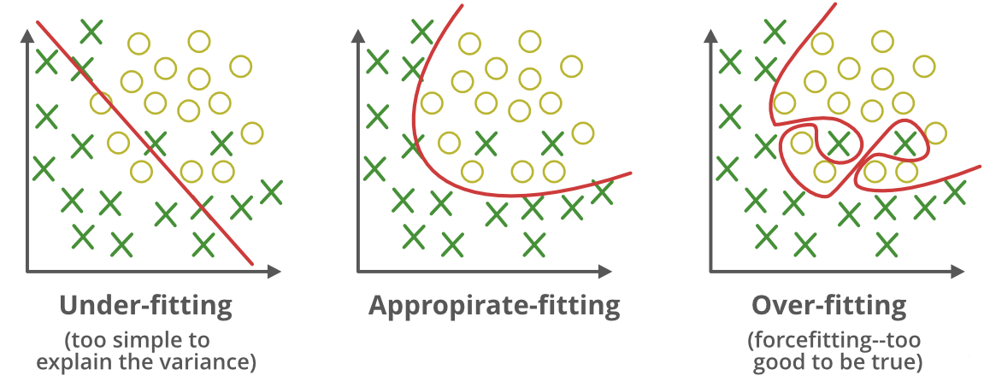
Problem of overfitting
A statistical model is said to be overfitted when we train it with a lot of data
When a model gets trained with so much data, it starts learning from the noise and inaccurate data entries in our data set.
Overfitting – High variance and low bias

Slide 3
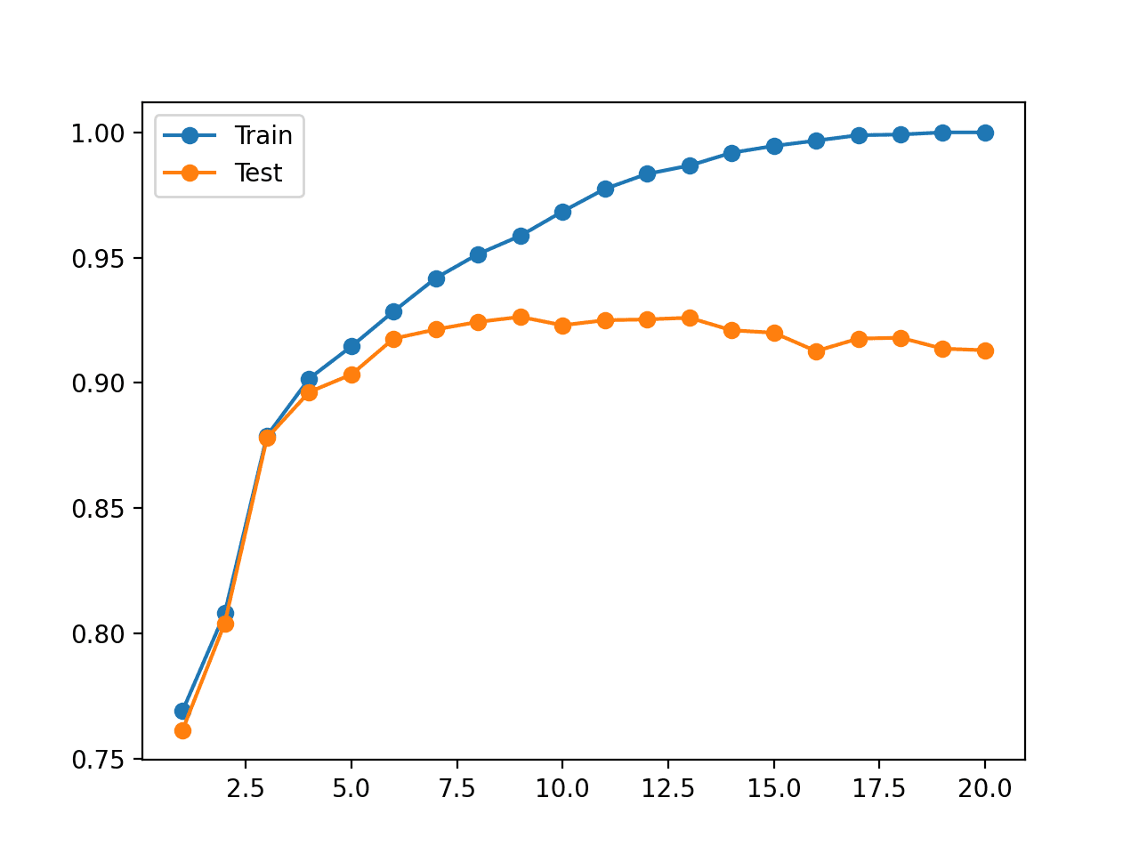
Identifying Overfitting models
When the model has very good accuracy and very low loss in training data but low accuracy and high loss in testing data.
When the model shows good results for first few epochs but becomes worse with the increasing complexity in the dataset.

Slide 4
Regularization
• Remember the intuition: complicated hypotheses lead to overfitting
• In general: any method to prevent overfitting or help the optimization
• Specifically: additional terms in the training optimization objective to prevent overfitting or help the optimization
• Idea: change the error function to penalize hypothesis complexity:
J(w) = JD(w) + λJ pen(w)
This is called regularization or shrinkage.
• λ is called regularization coefficient and controls how much we value fitting the data well, vs. a simple hypothesis

Slide 5
Regularization types
A regression model that uses L1 regularization technique is called Lasso Regression and model which uses L2 is called Ridge Regression.
Lasso Regression (Least Absolute Shrinkage and Selection Operator) This adds “absolute value of magnitude” of coefficient as penalty term to the loss function. This is also called L1 regularization.
Ridge regression This adds “squared magnitude” of coefficient as penalty term to the loss function. This is also called L2 regularization.

Slide 6
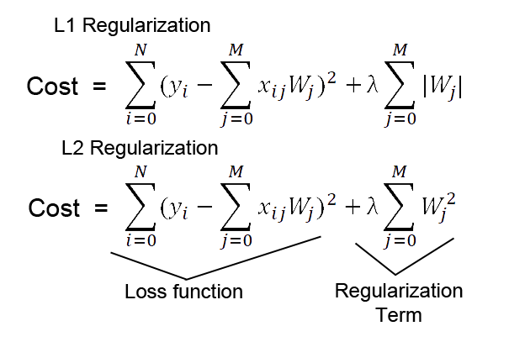
Regularization types
Regularization works by biasing data towards particular values (such as small values near zero).
The basic idea is to penalize the complex models
L1 regularization adds the penalty term in cost function by adding the absolute value of weight(Wj) parameters, while L2 regularization adds the squared value of weights(Wj) in the cost function.
The main intuitive difference between the L1 and L2 regularization is that L1 regularization tries to estimate the median of the data while the L2 regularization tries to estimate the mean of the data to avoid overfitting.

Slide 7
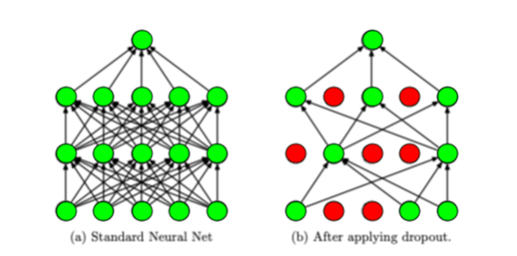
Dropout
“Dropout” in machine learning refers to the process of randomly ignoring certain nodes in a layer during training.

Slide 8
Dropout: An efficient way to average many large neural nets
Consider a neural net with one hidden layer.
Each time we present a training example, we randomly omit each hidden unit with probability 0.5.
So we are randomly sampling from 2^H different architectures.
We sample from 2^H models. So only a few of the models ever get trained, and they only get one training example.
The sharing of the weights means that every model is very strongly regularized.
It’s a much better regularizer than L2 or L1 penalties that pull the weights towards zero.

Slide 9
How?
Where?
Use a larger network.
Generally, use a small dropout value to start with.
Dropout can be used on incoming (visible) as well as hidden units.
Balancing - A probability too low has minimal effect and a value too high results in under-learning by the network.
Reduces complex co-adaptations.
Multiple independent internal representations
Less sensitive to the specific weights of neurons
Better generalization

Slide 10
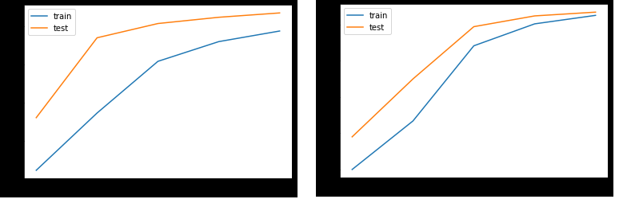
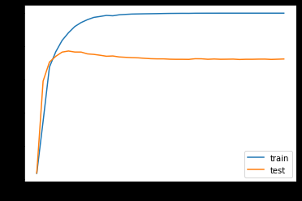
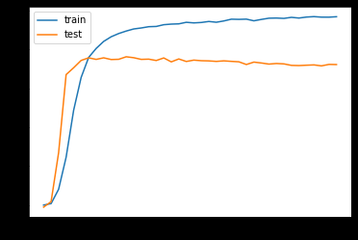
Results: Accuracy
Small dataset size. Model tries to fit every data
With Dropout Without Dropout
Increasing dataset size. When the test accuracy increases to a certain value, it begins to decrease again.

